Slide 1

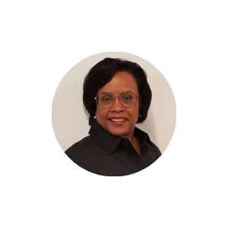
Empathy Map Template
Dr. Pamela Keye
Former Superintendent of Prince George’s County Public Schools
See
A trend toward learning pods/parent hubs could alter the EdTech marketplace, in terms of target audience, entirely.
It could go entirely virtual for some and not others – poverty could play a huge role.
Think & Feel
Uncertainty over the overall impact of COVID on teaching methods long term.
Helplessness over a lack of true direction in improving STEM education methods.
Say & Do
Being prepared to support both traditional and digital education platforms is good business.
Investing more proactively in the digital marketplace could be great business.
Traditional shouldn’t be abandoned, but AR/VR apps and software should support equitable access to wider integration.
Hear
All sides – parent/child, educators, vendors, even government – expressing frustration. Everyone wants solutions, so there is opportunity to break monopolies in the sector.
Accessibility and funding are primary concerns.
Traditional is often the only educational structure available to lower income students.
PAIN POINTS
Funding concerns.
Uncertainty
ASPIRATIONS
Equitable access to all forms of STEM learning.
Finding cohesive ways to advance the teaching of all STEM disciplines.
Notes:
For a full copy of the in-depth interview, email daylene@catapult-x.com

